Slide 1
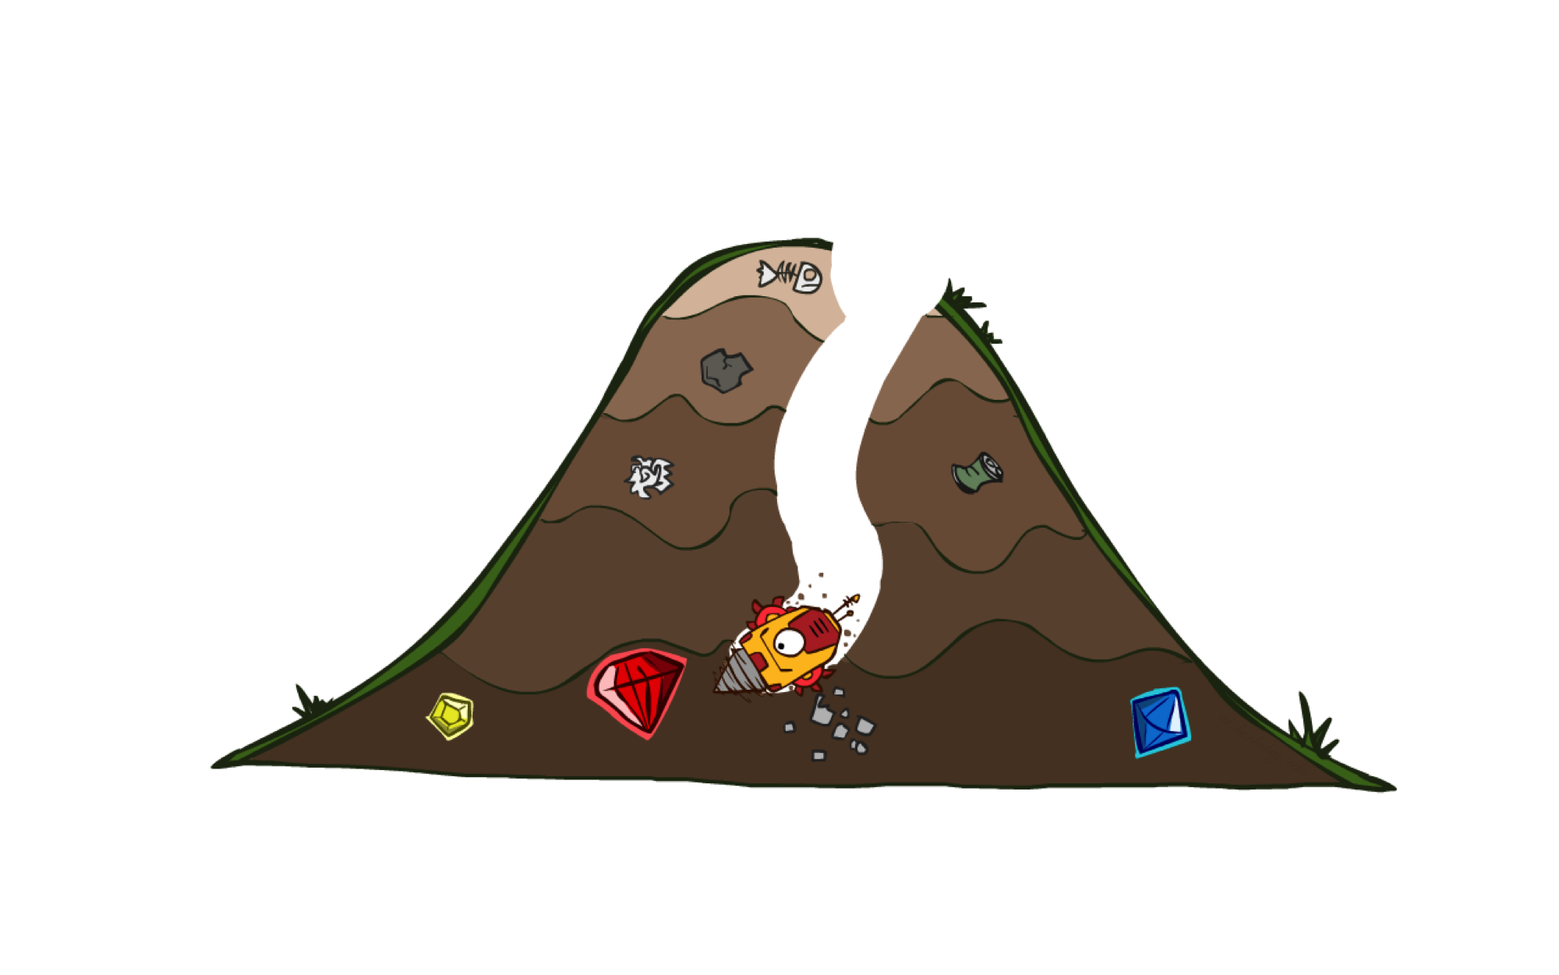

A* Search

Slide 2
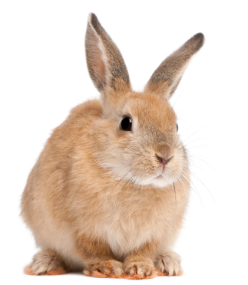
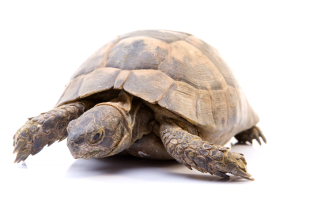

A* Search
UCS
Greedy
A*
Notes:
Notes: these images licensed from iStockphoto for UC Berkeley use.

Slide 3
Combining UCS and Greedy
Uniform-cost orders by path cost, or backward cost g(n)
Greedy orders by goal proximity, or forward cost h(n)
A* Search orders by the sum: f(n) = g(n) + h(n)
8
g = 0 h=6
S
e
h=1
g = 1 h=5
a
1
1
3
2
g = 2 h=6
g = 9 h=1
S
a
d
G
b
d
g = 4 h=2
e
h=6
1
h=5
h=2
h=0
1
g = 3 h=7
g = 6 h=0
g = 10 h=2
c
b
c
G
d
h=7
h=6
g = 12 h=0
G
Example: Teg Grenager

Slide 4
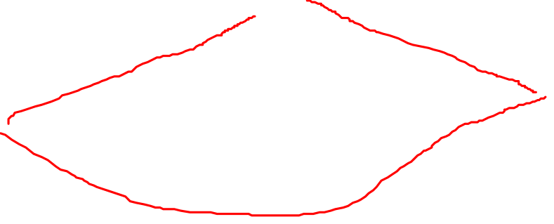
When should A* terminate?
Should we stop when we enqueue a goal?
No: only stop when we dequeue a goal
h = 2
A
2
2
S
h = 3
h = 0
G
2
B
3
h = 1

Slide 5

Is A* Optimal?
h = 6
1
A
3
S
h = 7
G
h = 0
5
What went wrong?
Actual bad goal cost < estimated good goal cost
We need estimates to be less than actual costs!

Slide 6

Admissible Heuristics

Slide 7

Idea: Admissibility
Inadmissible (pessimistic) heuristics break optimality by trapping good plans on the fringe
Admissible (optimistic) heuristics slow down bad plans but never outweigh true costs

Slide 8
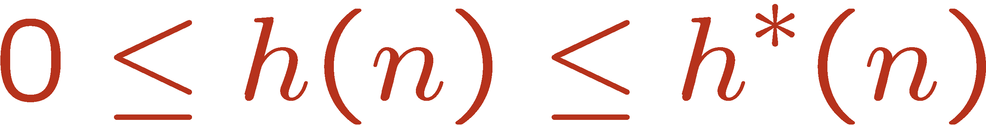


Admissible Heuristics
A heuristic h is admissible (optimistic) if:
where is the true cost to a nearest goal
Examples:
Coming up with admissible heuristics is most of what’s involved in using A* in practice.
4
15

